Slide 1


The cost of resource use for photosynthesis drives variance in leaf nitrogen content across a climate and soil resource availability gradient
Evan A. Perkowski; Nicholas G. Smith

Slide 2
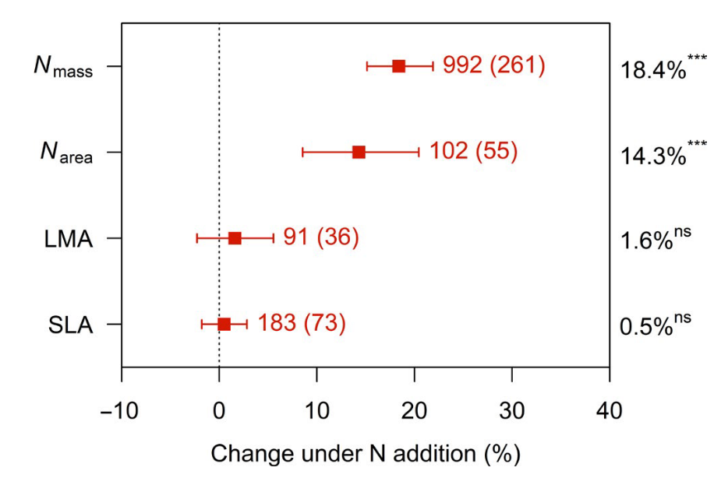
Soil nitrogen generally increases leaf nitrogen…
Liang et al. (2020) Global Change Biology

Slide 3
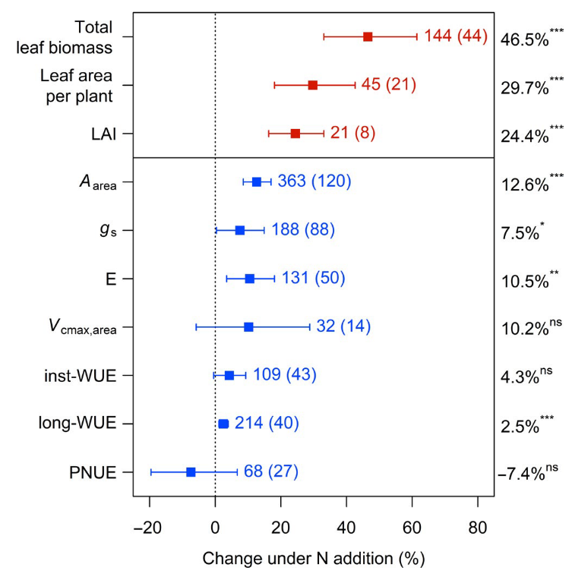
… which often corresponds with increased photosynthesis
Liang et al. (2020) Global Change Biology

Slide 4
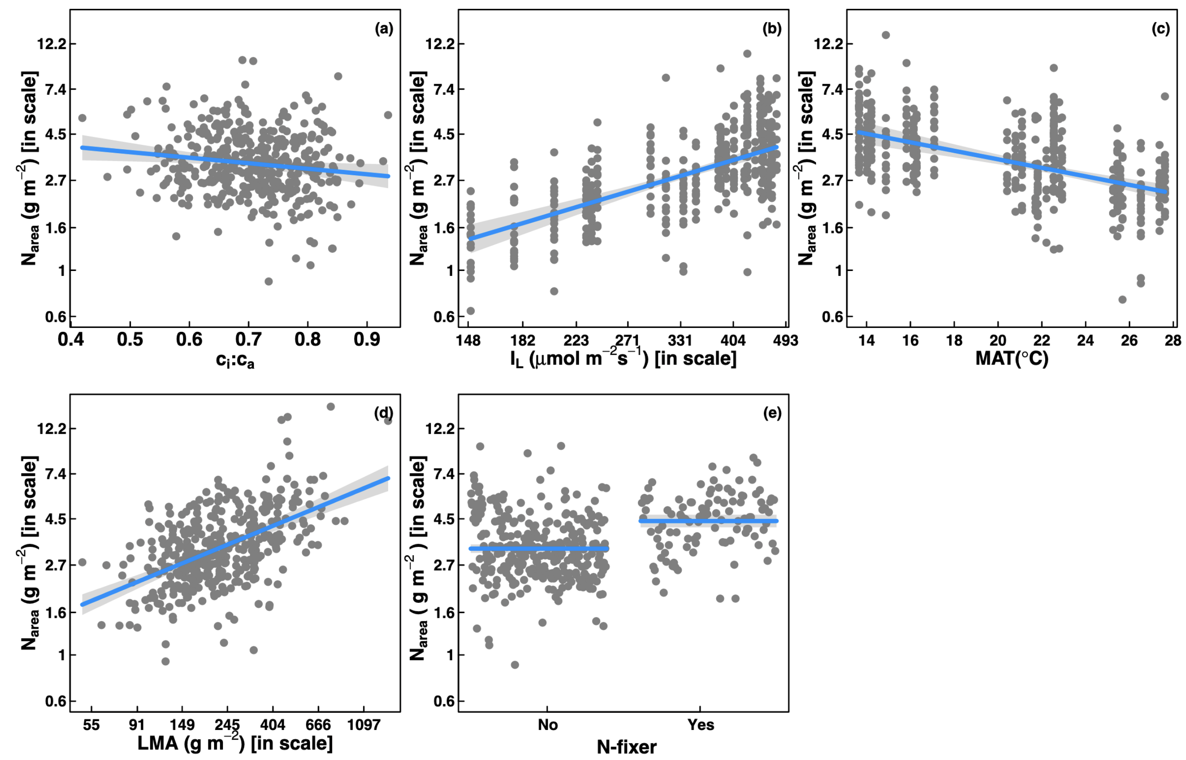
However, leaf nitrogen can be predicted independent of soil nitrogen
Dong et al. (2017) Biogeosciences
Notes:
Some recent work has also shown that leaf nitrogen can be predicted independent of soil nitrogen availability
This is work from Ning Dong showing on the top row in panel b and c that leaf nitrogen can be predicted from photosynthetically active radiation, which is basically light, and mean annual temperature.
Additionally, they show in panel a that leaf nitrogen can be predicted by the ratio of intercellular carbon dioxide to extracellular carbon dioxide, or Ci:Ca,
In panel d, they show that leaf nitrogen can be predicted through the ratio of intercellular carbon dioxide to atmospheric carbon dioxide, and in panel e show that leaf nitrogen can be predicted on the basis of whether a species can associate with nitrogen-fixing bacteria
Thus, aboveground climate and leaf traits can be used to predict patterns of leaf nitrogen

Slide 5
Leaf nitrogen is likely a product of interactions between climatic and edaphic factors
Notes:
While we know that variation in leaf nitrogen can be explained by soil nitrogen availability, climate, or plant traits, we still do not have a firm grasp of what drives leaf nitrogen content.
It is possible that these patterns are driven by plant allocation responses to soil nitrogen and climate, but we lack data that links these responses to physiological processes that range from the leaf to whole plant level
Yet, we do not fully understand when and where soil nitrogen impacts nitrogen allocation to leaf tissue vs. other tissues

Slide 6
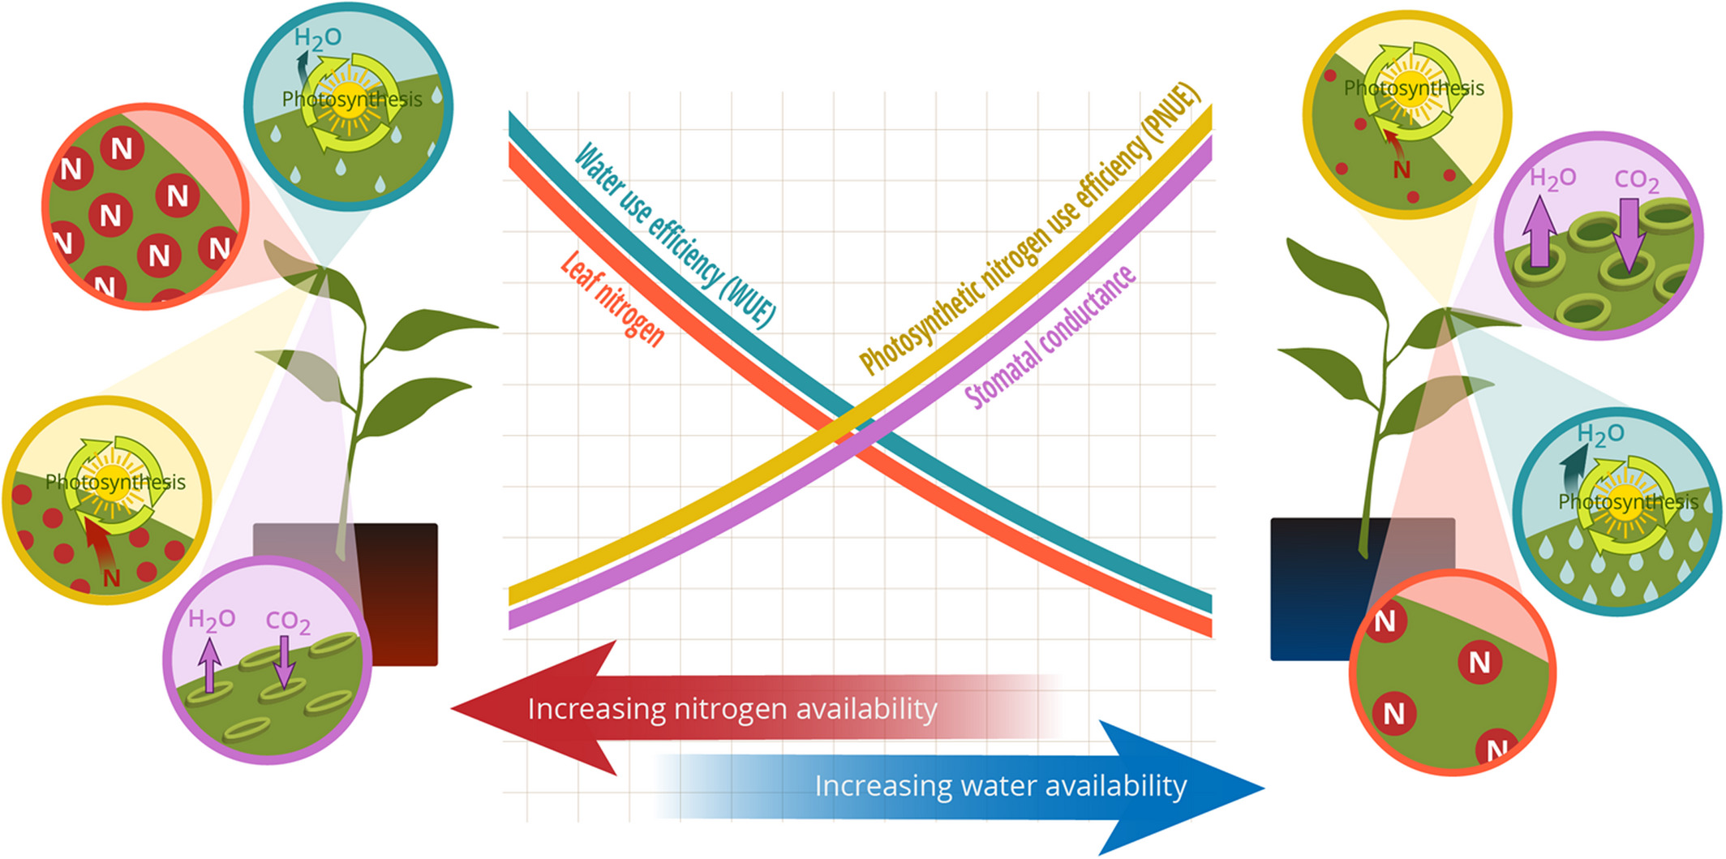
Photosynthetic least-cost theory: leaves acclimate to changing climatic and edaphic environments via summed cost of resource use (nitrogen and water)
Bialic-Murphy et al. (2021) Ecology Letters
Notes:
At the leaf level, plants might allocate nitrogen to photosynthetic leaf tissue in order to preserve water
This option can be explained through recent frameworks suggesting that plants can and should maximize photosynthetic carbon gain by trading inefficient use of an abundant resource for efficiency a more limited limiting resource.
For example, if nitrogen is relatively more available than water, then plants can maintain a similar photosynthetic output by increasing nitrogen allocation toward photosynthetic leaf tissue in order to increase water-use efficiency., effectively employing a water-savings mechanism
We might expect these patterns would be observed in arid systems where water is relatively less available than nitrogen, although these patterns haven’t necessarily been tested in temperate regions

Slide 7
Photosynthetic least-cost theory: leaves acclimate to changing climatic and edaphic environments via summed cost of resource use (nitrogen and water)
Bialic-Murphy et al. (2021) Ecology Letters
Notes:
At the leaf level, plants might allocate nitrogen to photosynthetic leaf tissue in order to preserve water
This option can be explained through recent frameworks suggesting that plants can and should maximize photosynthetic carbon gain by trading inefficient use of an abundant resource for efficiency a more limited limiting resource.
For example, if nitrogen is relatively more available than water, then plants can maintain a similar photosynthetic output by increasing nitrogen allocation toward photosynthetic leaf tissue in order to increase water-use efficiency., effectively employing a water-savings mechanism
We might expect these patterns would be observed in arid systems where water is relatively less available than nitrogen, although these patterns haven’t necessarily been tested in temperate regions

Slide 8
Photosynthetic least-cost theory: leaves acclimate to changing climatic and edaphic environments via summed cost of resource use (nitrogen and water)
“β”
Bialic-Murphy et al. (2021) Ecology Letters
Notes:
At the leaf level, plants might allocate nitrogen to photosynthetic leaf tissue in order to preserve water
This option can be explained through recent frameworks suggesting that plants can and should maximize photosynthetic carbon gain by trading inefficient use of an abundant resource for efficiency a more limited limiting resource.
For example, if nitrogen is relatively more available than water, then plants can maintain a similar photosynthetic output by increasing nitrogen allocation toward photosynthetic leaf tissue in order to increase water-use efficiency., effectively employing a water-savings mechanism
We might expect these patterns would be observed in arid systems where water is relatively less available than nitrogen, although these patterns haven’t necessarily been tested in temperate regions

Slide 9
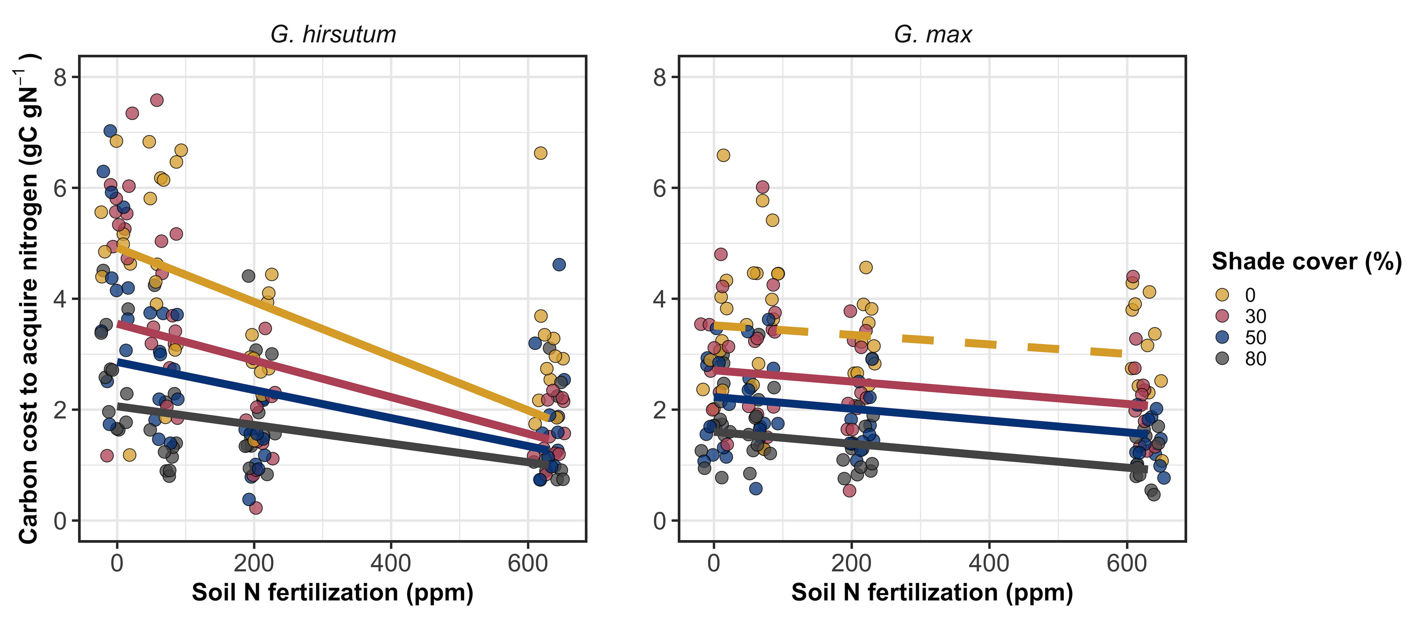
β is held constant in least-cost optimality models, but varies across environments
Perkowski et al. (2021) Journal of Experimental Botany

Slide 10
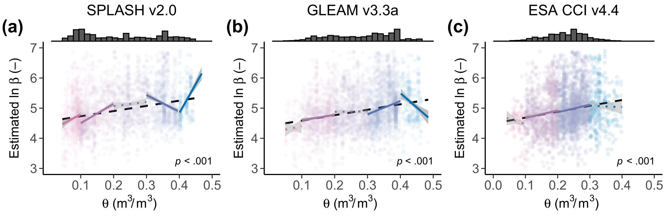
β is held constant in least-cost optimality models, but varies across environments
Lavergne et al. (2020) Global Change Biology

Slide 11
Open questions

Slide 12
Hypotheses
SM₉₀
N_{fixer}
VPD₄
N_{mass}
β
C_{i}:C_{a}
Ν_{area}
Soil N
C₃/C₄
M_{area}
Positive
Negative

Slide 13
The cost of acquiring and using nutrients (β) will be modified by soil resources and species identity
SM₉₀
N_{fixer}
VPD₄
N_{mass}
β
C_{i}:C_{a}
Ν_{area}
Soil N
C₃/C₄
M_{area}
Positive
Negative

Slide 14
Leaf C_{i}:C_{a} will be modified by costs of resource use and aboveground climate
SM₉₀
N_{fixer}
VPD₄
N_{mass}
β
C_{i}:C_{a}
Ν_{area}
Soil N
C₃/C₄
M_{area}
Positive
Negative

Slide 15
Leaf nitrogen content will be negatively related to leaf C_{i}:C_{a}
SM₉₀
N_{fixer}
VPD₄
N_{mass}
β
C_{i}:C_{a}
Ν_{area}
Soil N
C₃/C₄
M_{area}
Positive
Negative

Slide 16
Soil N may directly increase N_{area} due to increasing N_{mass}…
SM₉₀
N_{fixer}
VPD₄
N_{mass}
β
C_{i}:C_{a}
Ν_{area}
Soil N
C₃/C₄
M_{area}
Positive
Negative

Slide 17
… or may indirectly increase N_{area} due to reductions in the cost of acquiring nitrogen
SM₉₀
N_{fixer}
VPD₄
N_{mass}
β
C_{i}:C_{a}
Ν_{area}
Soil N
C₃/C₄
M_{area}
Positive
Negative

Slide 18
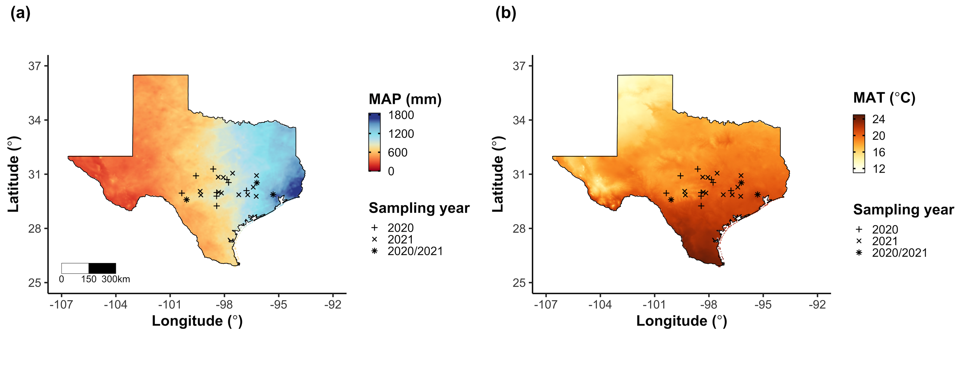
Field gradient experiment
24 sites
12 visited in 2020
15 visited in 2021 (3 from 2020)
3 leaves of 5 most dominant species at each site
Leaf nitrogen content
Leaf C_{i}:C_{a} (δ¹³C)
Cost of acquiring nitrogen relative to water (β)
Composite soil sample
[NO₃-N]

Slide 19
Climate and edaphic characteristics
PRISM data product (4-km grid across coterminous US)
Daily air temperature
Daily vapor pressure deficit
Daily precipitation
Soil moisture derived from SPLASHv1.0 model
As function of water holding capacity

Slide 20
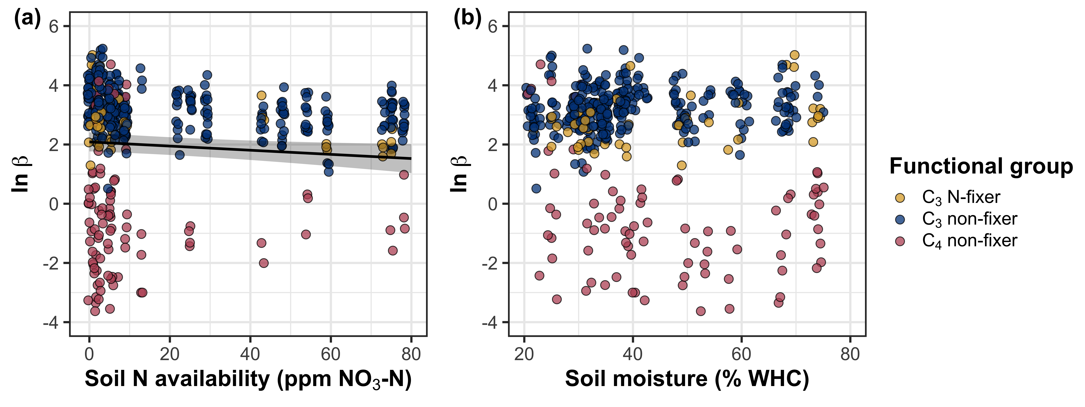
β decreases with increasing soil nitrogen, but is not modified by soil moisture

Slide 21
β decreases with increasing soil nitrogen, but is not modified by soil moisture

Slide 22
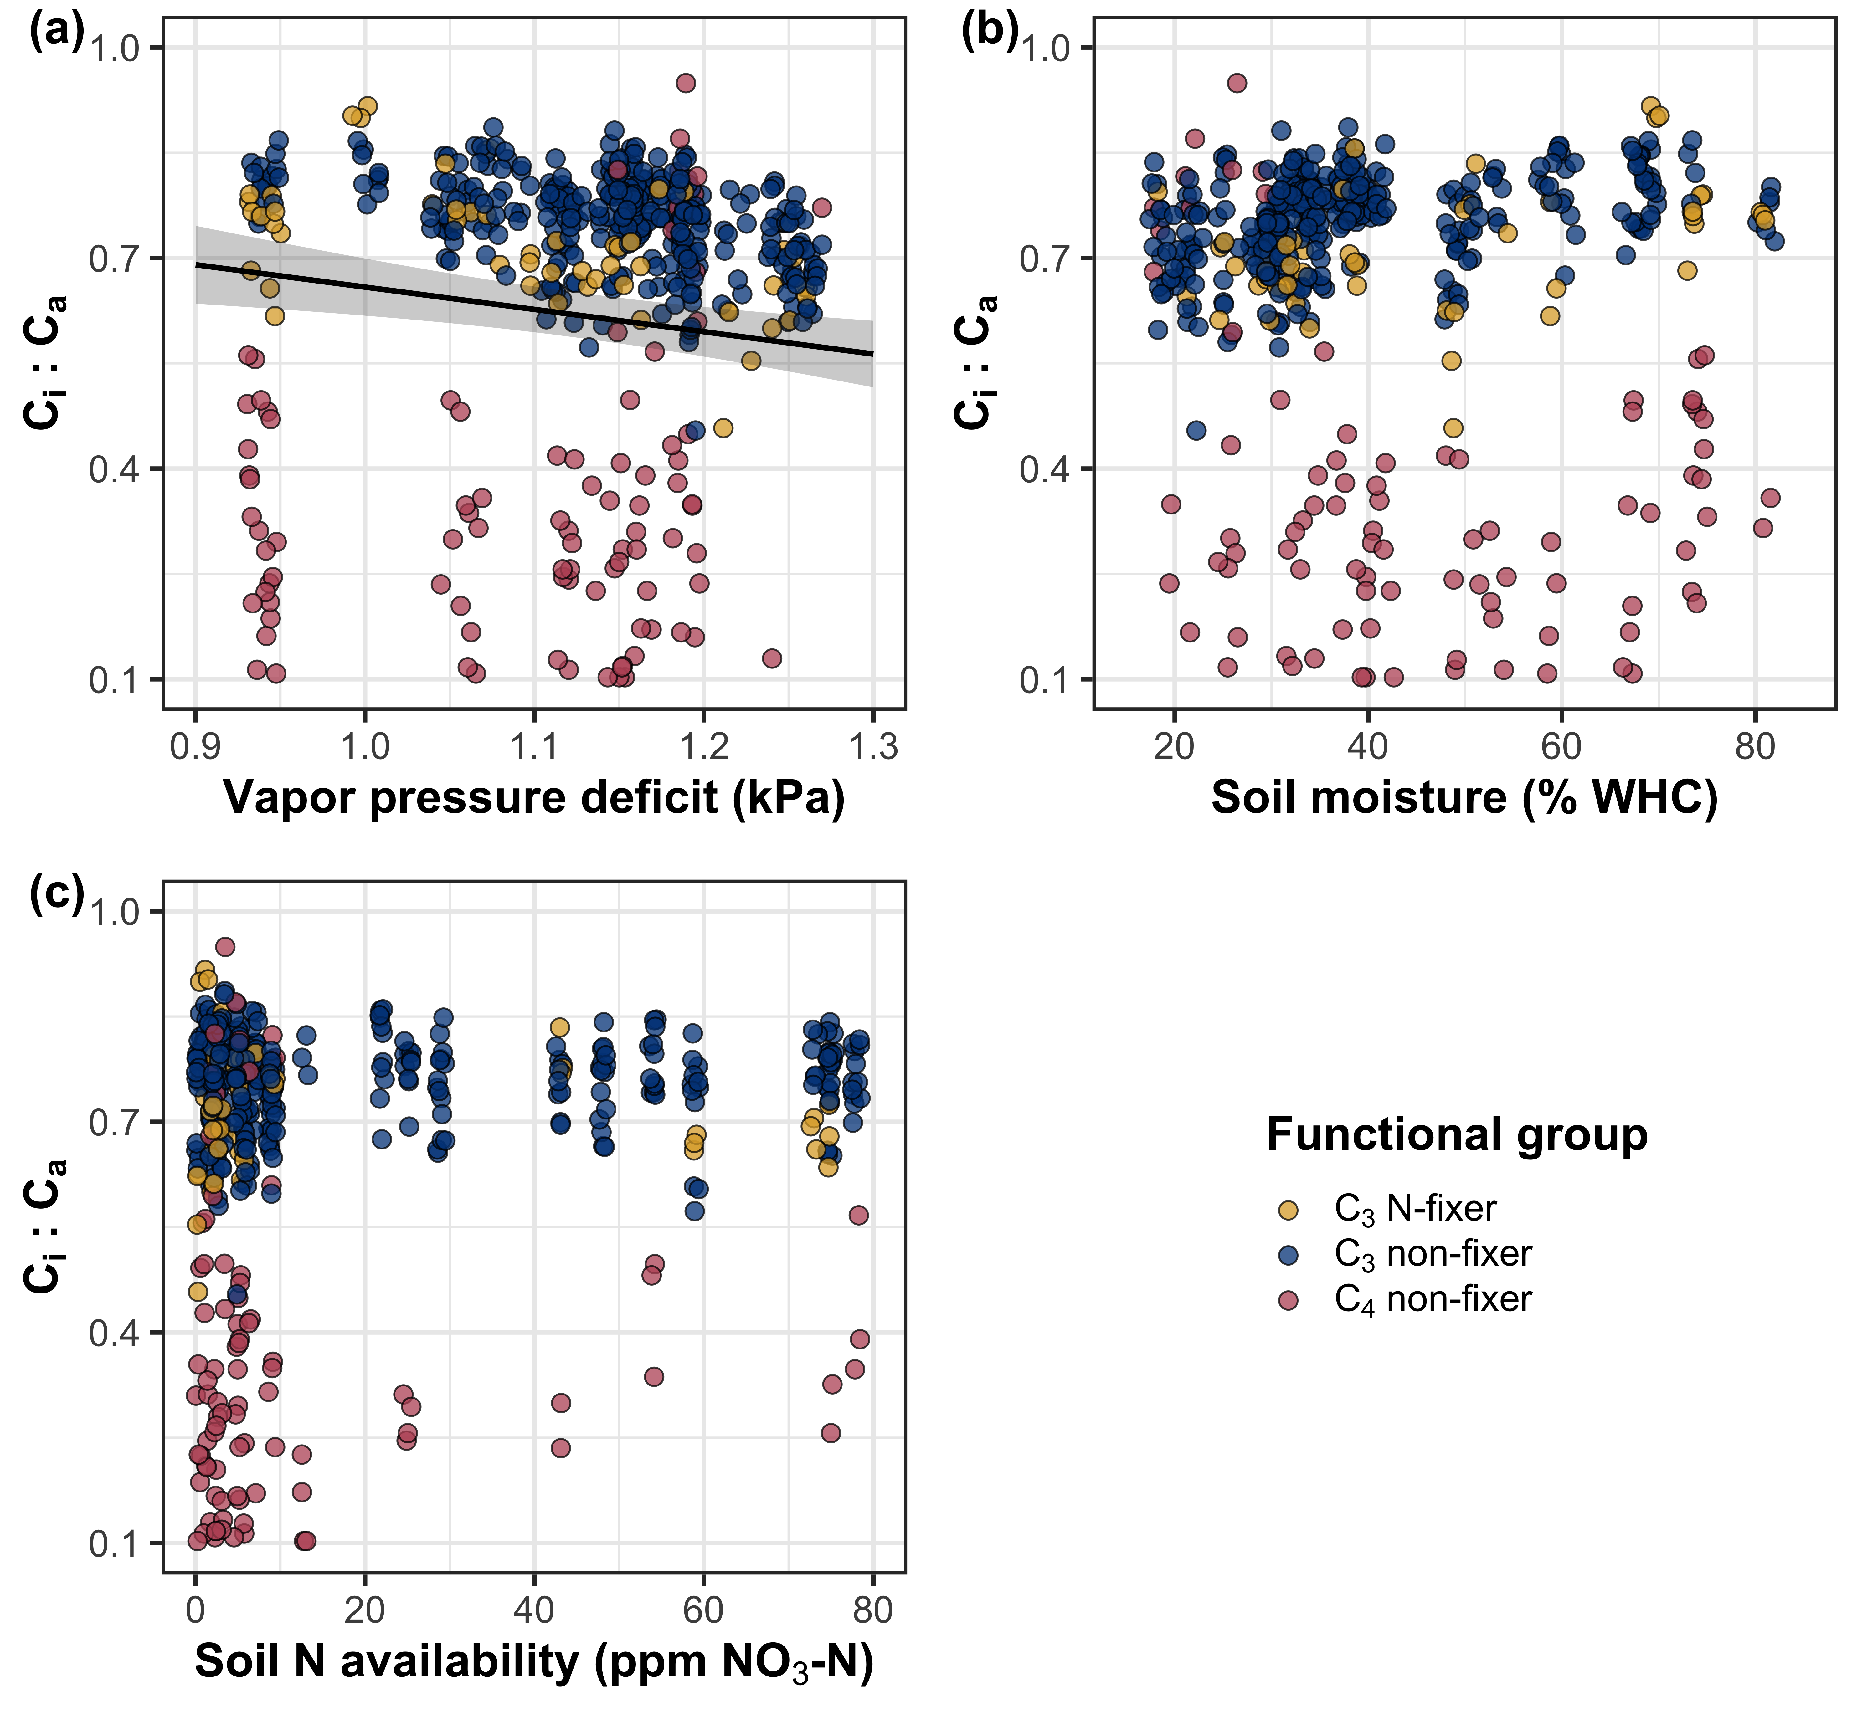
Leaf C_{i}:C_{a} decreases with increasing vapor pressure deficit, but is not modified by edaphic factors

Slide 23
N_{area} increases with increasing soil nitrogen availability

Slide 24
N_{area} increases with increasing soil nitrogen availability

Slide 25
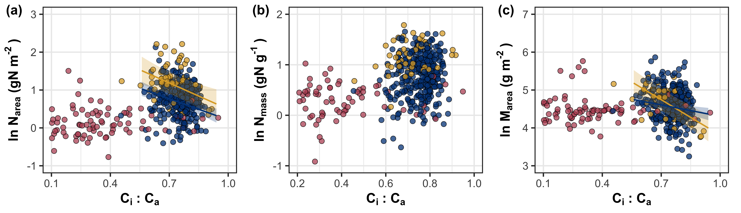
N_{area} is negatively associated with leaf C_{i}:C_{a} due to reductions in M_{area}

Slide 26
SM₉₀
N_{fixer}
VPD₄
N_{mass}
β
C_{i}:C_{a}
Ν_{area}
Soil N
C₃/C₄
M_{area}
Positive
Negative

Slide 27
SM₉₀
N_{fixer}
VPD₄
N_{mass}
β
C_{i}:C_{a}
Ν_{area}
Soil N
C₃/C₄
M_{area}
Positive
Negative

Slide 28
β is negatively associated with increasing soil nitrogen, and generally lower in C₄ species
SM₉₀
N_{fixer}
VPD₄
N_{mass}
β
C_{i}:C_{a}
Ν_{area}
Soil N
C₃/C₄
M_{area}
Positive
Negative

Slide 29
SM₉₀
N_{fixer}
VPD₄
N_{mass}
β
C_{i}:C_{a}
Ν_{area}
Soil N
C₃/C₄
M_{area}
Positive
Negative

Slide 30
Leaf C_{i}:C_{a} is negatively related to increasing vapor pressure deficit and positively related to β
SM₉₀
N_{fixer}
VPD₄
N_{mass}
β
C_{i}:C_{a}
Ν_{area}
Soil N
C₃/C₄
M_{area}
Positive
Negative

Slide 31
SM₉₀
N_{fixer}
VPD₄
N_{mass}
β
C_{i}:C_{a}
Ν_{area}
Soil N
C₃/C₄
M_{area}
Positive
Negative

Slide 32
M_{area} is negatively related to leaf C_{i}:C_{a}, while N_{mass} is positively related to leaf C_{i}:C_{a}
SM₉₀
N_{fixer}
VPD₄
N_{mass}
β
C_{i}:C_{a}
Ν_{area}
Soil N
C₃/C₄
M_{area}
Positive
Negative

Slide 33
SM₉₀
N_{fixer}
VPD₄
N_{mass}
β
C_{i}:C_{a}
Ν_{area}
Soil N
C₃/C₄
M_{area}
Positive
Negative

Slide 34
Increasing soil nitrogen availability directly increases N_{mass} and decreases M_{area}
SM₉₀
N_{fixer}
VPD₄
N_{mass}
β
C_{i}:C_{a}
Ν_{area}
Soil N
C₃/C₄
M_{area}
Positive
Negative

Slide 35
SM₉₀
N_{fixer}
VPD₄
N_{mass}
β
C_{i}:C_{a}
Ν_{area}
Soil N
C₃/C₄
M_{area}
Positive
Negative

Slide 36
N-fixation ability directly increases N_{mass}
SM₉₀
N_{fixer}
VPD₄
N_{mass}
β
C_{i}:C_{a}
Ν_{area}
Soil N
C₃/C₄
M_{area}
Positive
Negative

Slide 37
SM₉₀
N_{fixer}
VPD₄
N_{mass}
β
C_{i}:C_{a}
Ν_{area}
Soil N
C₃/C₄
M_{area}
Positive
Negative

Slide 38
M_{area} is negatively associated with N_{mass}
SM₉₀
N_{fixer}
VPD₄
N_{mass}
β
C_{i}:C_{a}
Ν_{area}
Soil N
C₃/C₄
M_{area}
Positive
Negative

Slide 39
SM₉₀
N_{fixer}
VPD₄
N_{mass}
β
C_{i}:C_{a}
Ν_{area}
Soil N
C₃/C₄
M_{area}
Positive
Negative

Slide 40
Soil moisture was positively associated with soil nitrogen availability
SM₉₀
N_{fixer}
VPD₄
N_{mass}
β
C_{i}:C_{a}
Ν_{area}
Soil N
C₃/C₄
M_{area}
Positive
Negative

Slide 41
SM₉₀
N_{fixer}
VPD₄
N_{mass}
β
C_{i}:C_{a}
Ν_{area}
Soil N
C₃/C₄
M_{area}
Positive
Negative

Slide 42
Soil N directly increased N_{area} due to changes in N_{mass}…
55%
SM₉₀
N_{fixer}
VPD₄
N_{mass}
38%
82%
89%
β
C_{i}:C_{a}
Ν_{area}
35%
56%
Soil N
C₃/C₄
M_{area}
Positive
Negative

Slide 43
… and indirectly increased N_{area} due to reductions in β
55%
SM₉₀
N_{fixer}
VPD₄
N_{mass}
38%
82%
89%
β
C_{i}:C_{a}
Ν_{area}
35%
56%
Soil N
C₃/C₄
M_{area}
Positive
Negative

Slide 44
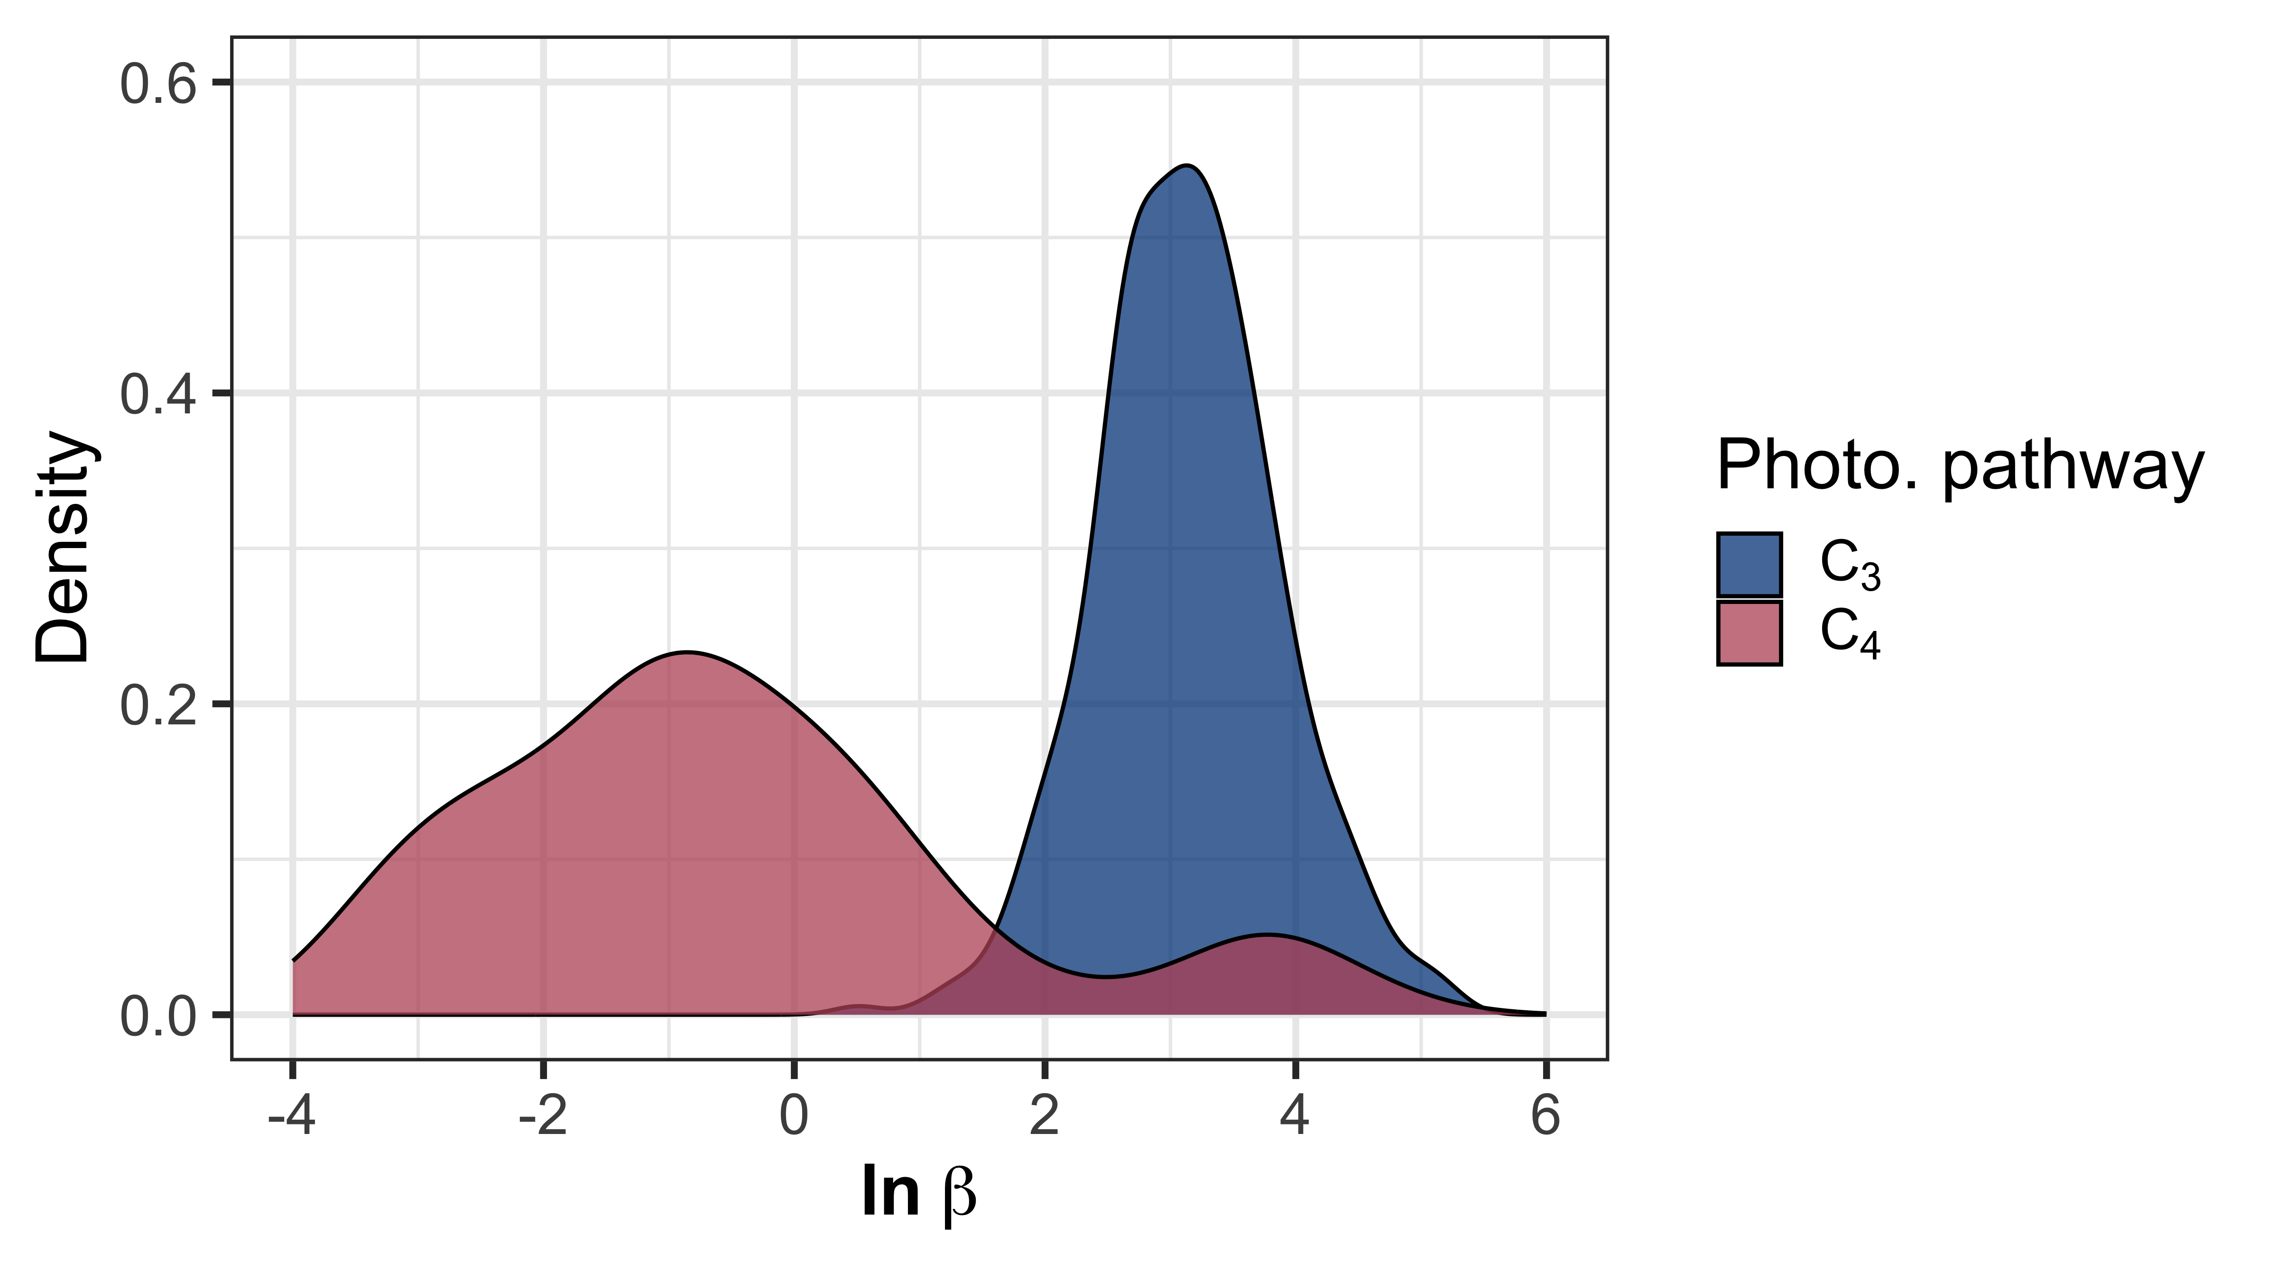
Conclusions
β dynamically changes across environments
Soil N is more important for determining variance in β than soil moisture
Leaf N is both a direct and indirect product of soil N availability

Slide 45
Conclusions
β dynamically changes across environments
Soil N is more important for determining variance in β than soil moisture
Leaf N is both a direct and indirect product of soil N availability
SM₉₀
N_{fixer}
β
Soil N
C₃/C₄

Slide 46
Conclusions
β dynamically changes across environments
Soil N is more important for determining variance in β than soil moisture
Leaf N is both a direct and indirect product of soil N availability
N_{mass}
β
C_{i}:C_{a}
Ν_{area}
Soil N
M_{area}

Slide 47

Acknowledgements
Field and lab assistance (*UG mentees)
Risa McNellis
Jorge Ochoa*
Peter Eludini
Christine Vanginault*
Abigail Bell*
Jose Villeda*
Hannah German*
Avery Schoenherr*

Slide 48


Slide 49
Extra slides

Slide 50
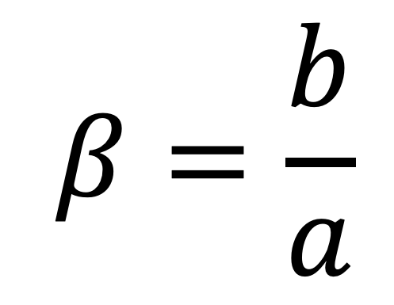
Resource unit cost ratio (β)
cost of acquiring and using N
$$β=\frac{b}{a}$$
cost of acquiring and using H₂O

Slide 51
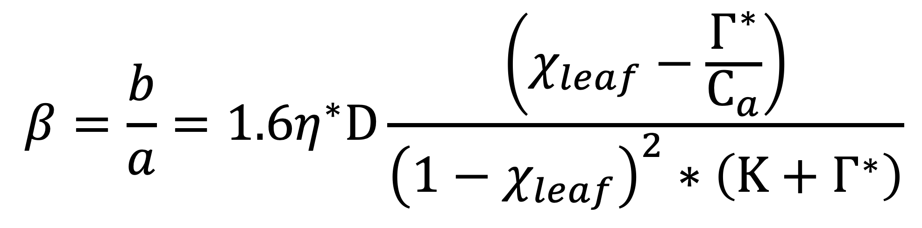
Resource unit cost ratio (β)
$$β=\frac{b}{a}=1.6η^{∗}D\frac{\left(χ_{leaf}−\frac{Γ^{∗}}{C_{a}}\right)}{{\left(1−χ_{leaf}\right)}^{2}∗\left(Κ+Γ^{∗}\right)}$$
Notes:
We used the following field manipulation experiment to investigate whether changes in soil resource availability influenced leaf quantity/quality tradeoffs or water/nitrogen use tradeoffs.
Starting in 2010, our coauthor Christy Goodale set up a full-factorial nitrogen-by-sulfur field manipulation experiment at three sites in a contiguous closed canopy forest all within a 20-km radius of Ithaca, New York
This experiment was originally created to tease apart the impacts of soil pH change and soil nitrogen fertilization on forest ecosystem functions;
however, because sulfur additions acidify the soil and promote nitrogen losses over time, this system provides a unique soil nitrogen availability gradient to test our hypotheses

